Slide 1
unacademy
India’s Largest learning platform

Slide 2

WHAT WE DO?
Unacademy
We are the bridge between highly experienced tutors and students with lack of resources. Providing free platform to the students to learn, educate and ace in their respective exams.
Tutors
Brilliant, dynamic and result oriented tutors with not only rich experience in teaching but also very much updated in their respective fields
Students
Every year around 10 million plus students prepare for one or the other competitive exams but most of which are not ahead in competitions due to lack of resources.

Slide 3
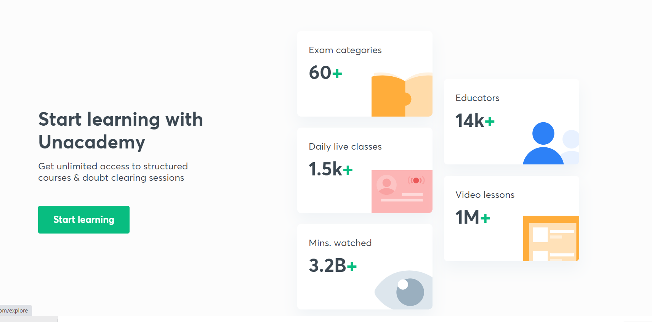

Slide 4
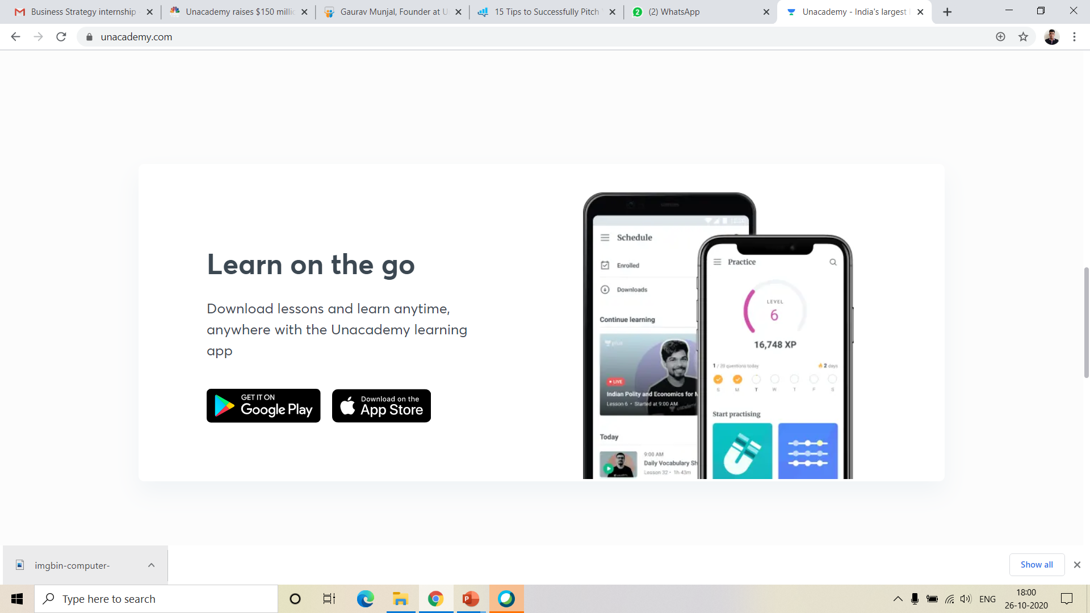
Our Portable solution for learning by creating an app

Slide 5
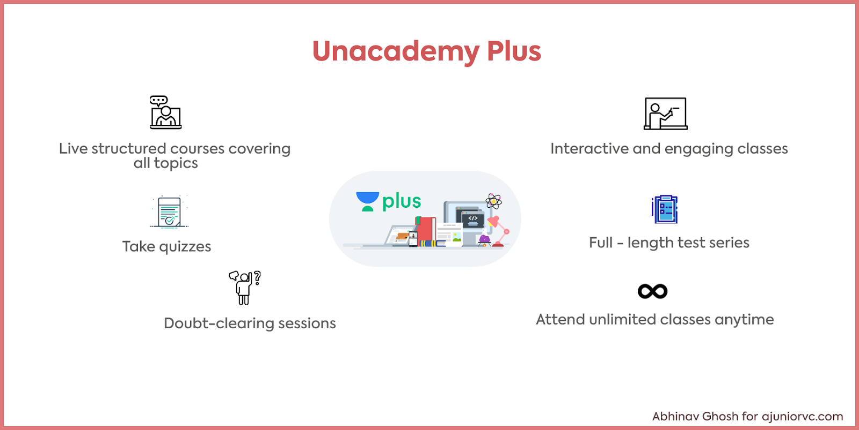

Slide 6

How do we Generate Revenue
Personalized sessions with the educators - now that you have taken a course on Unacademy.in, to take a personal session or asking a doubt for which you need an answer on a personal basis you can pay a fee directly to the educator, we take a cut for the same as a platform
01
Subscription model - viewing courses is absolutely free but we might add more features like viewing videos offline on app, like tests and a personal coach to help you with learning for which we might charge 200-300 Rupees per month which is optional and which will not stop you from taking courses
02

Slide 7
Students
Funds to Grow More and Wide
Presently data base of more than 3.5 lakhs of verified subscribers and more than 18000 tutors are our true strengths.
We have proven our selves in e-learning models that are really useful for society and also we have provided much employments yet we need to furnish ourself and reach to every corner of nation.
Strengths
Weaknesses
Opportunities
Threats
SWOT
Unreached corners of nation
Other E-learning Platforms
Despite of having such a huge base of subscribers we still know that many more students needs to know about our facilities.
We can see there are so many platforms available today with a student to prepare themselves but unacademy is growing faster then any other platform reason being our free services so there are threats from others who can defeat us just by showing their funding capabilities

Slide 8
Why To Invest in Unacademy ?
Because stats speak more truth than humans

Slide 9
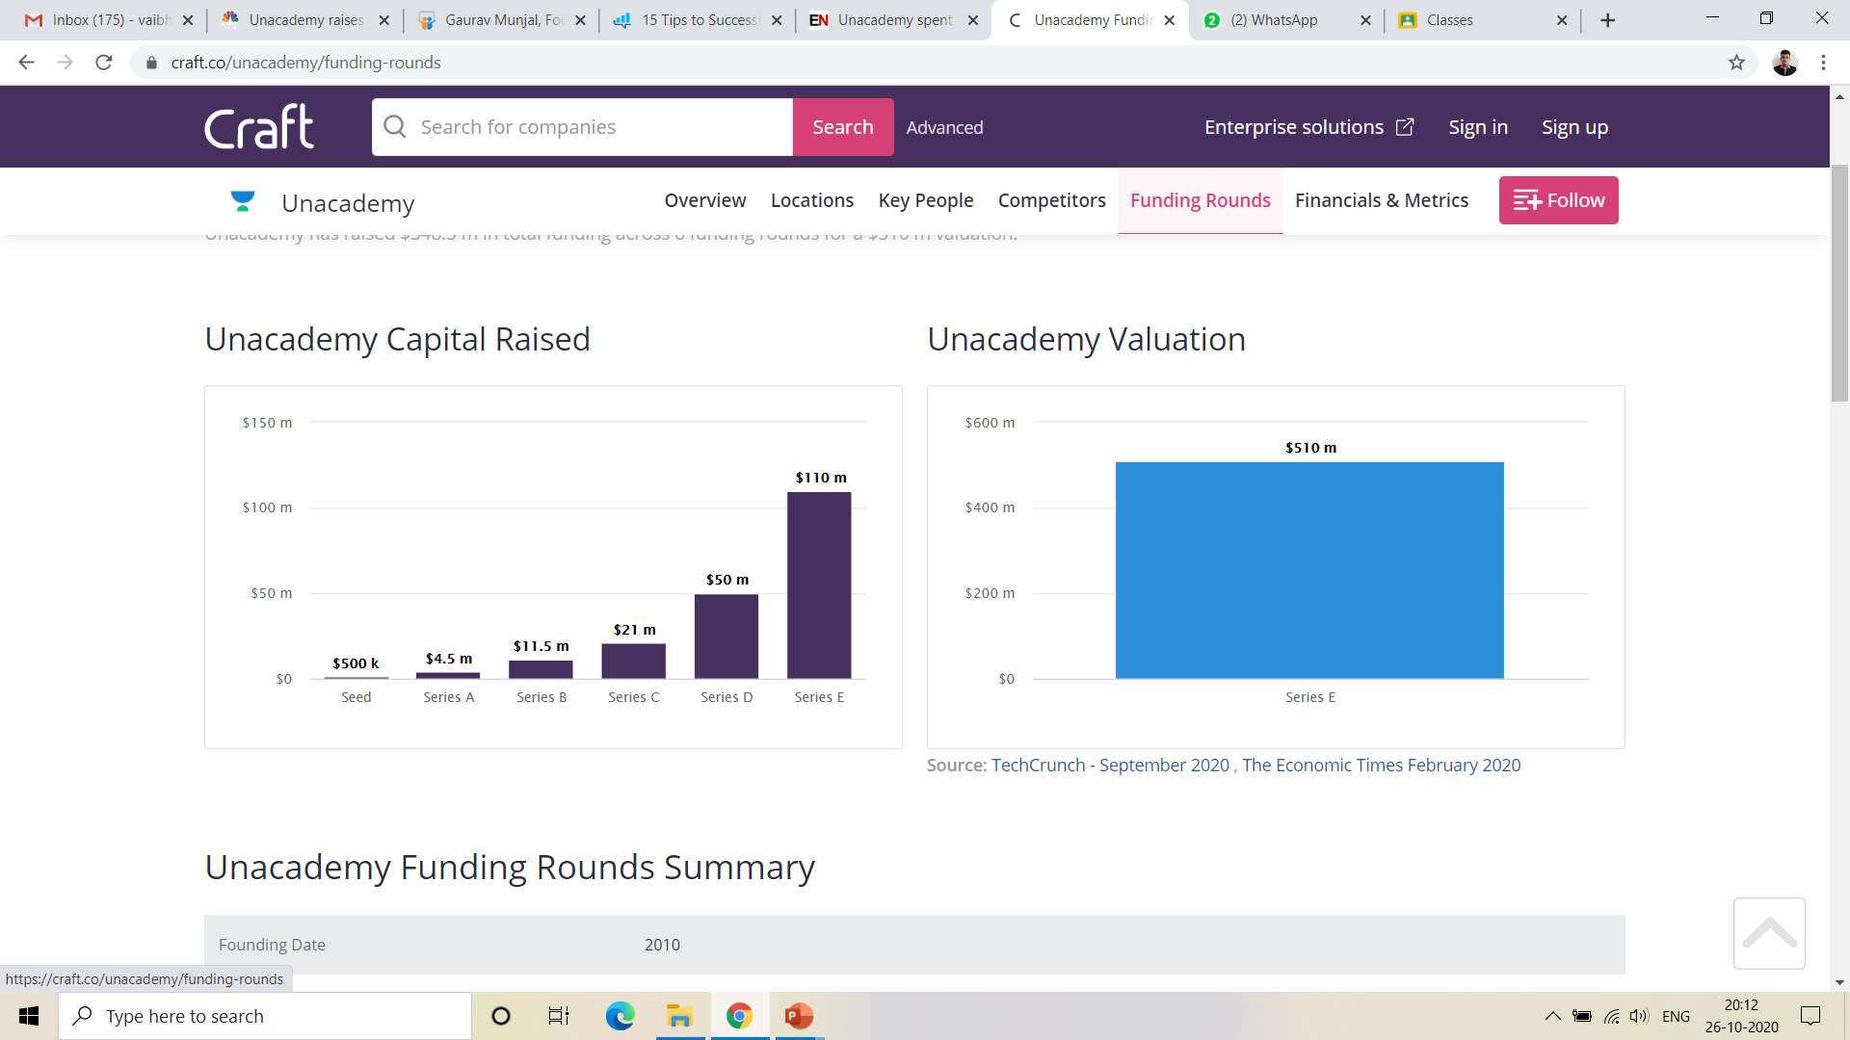
Unacademy Capital Raised
May 2016
Jan 2017
Sept 2017
Jul 2018
Jun 2019
Feb 2020
Also, in last fund raising round which is Series F round has raised $150m, in September 2020.

Slide 10
Unacademy Valuation

Slide 11
Unacademy Investors
Sequoia Capital
Nexus Venture Partners
Steadview Capital
General Atlantic
Blume Ventures
SAIF Partners
Rajan Anandan
Stanford Angels and Entrepreneurs
Facebook
Flipkart
Phanindra Sama
Aprameya Radhakrishna
Sumit Jain
Sujeet Kumar
Girish Mathrubootham
Ashish Tulsian
Ananth Narayanan
Sequoia India
Sequoia Capital India
Roman Saini
Gaurav Munjal
Nexus
Steadview
Kalyan Krishnamurthy
SoftBank Vision Fund 2
Nexus Partners

Slide 12
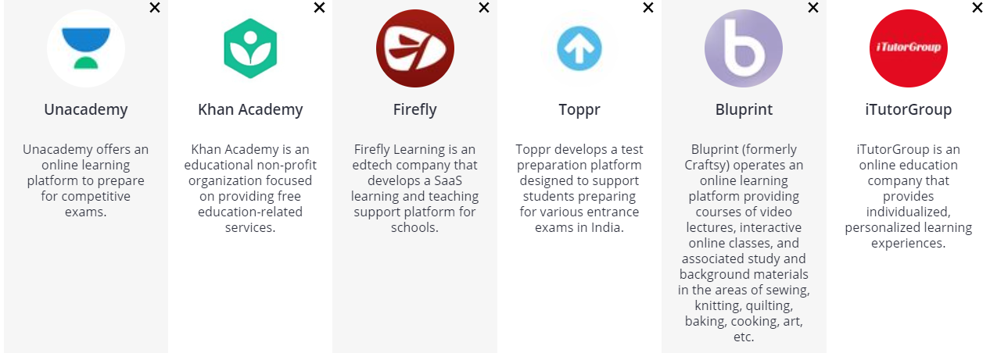
Competitor Analysis

Slide 13
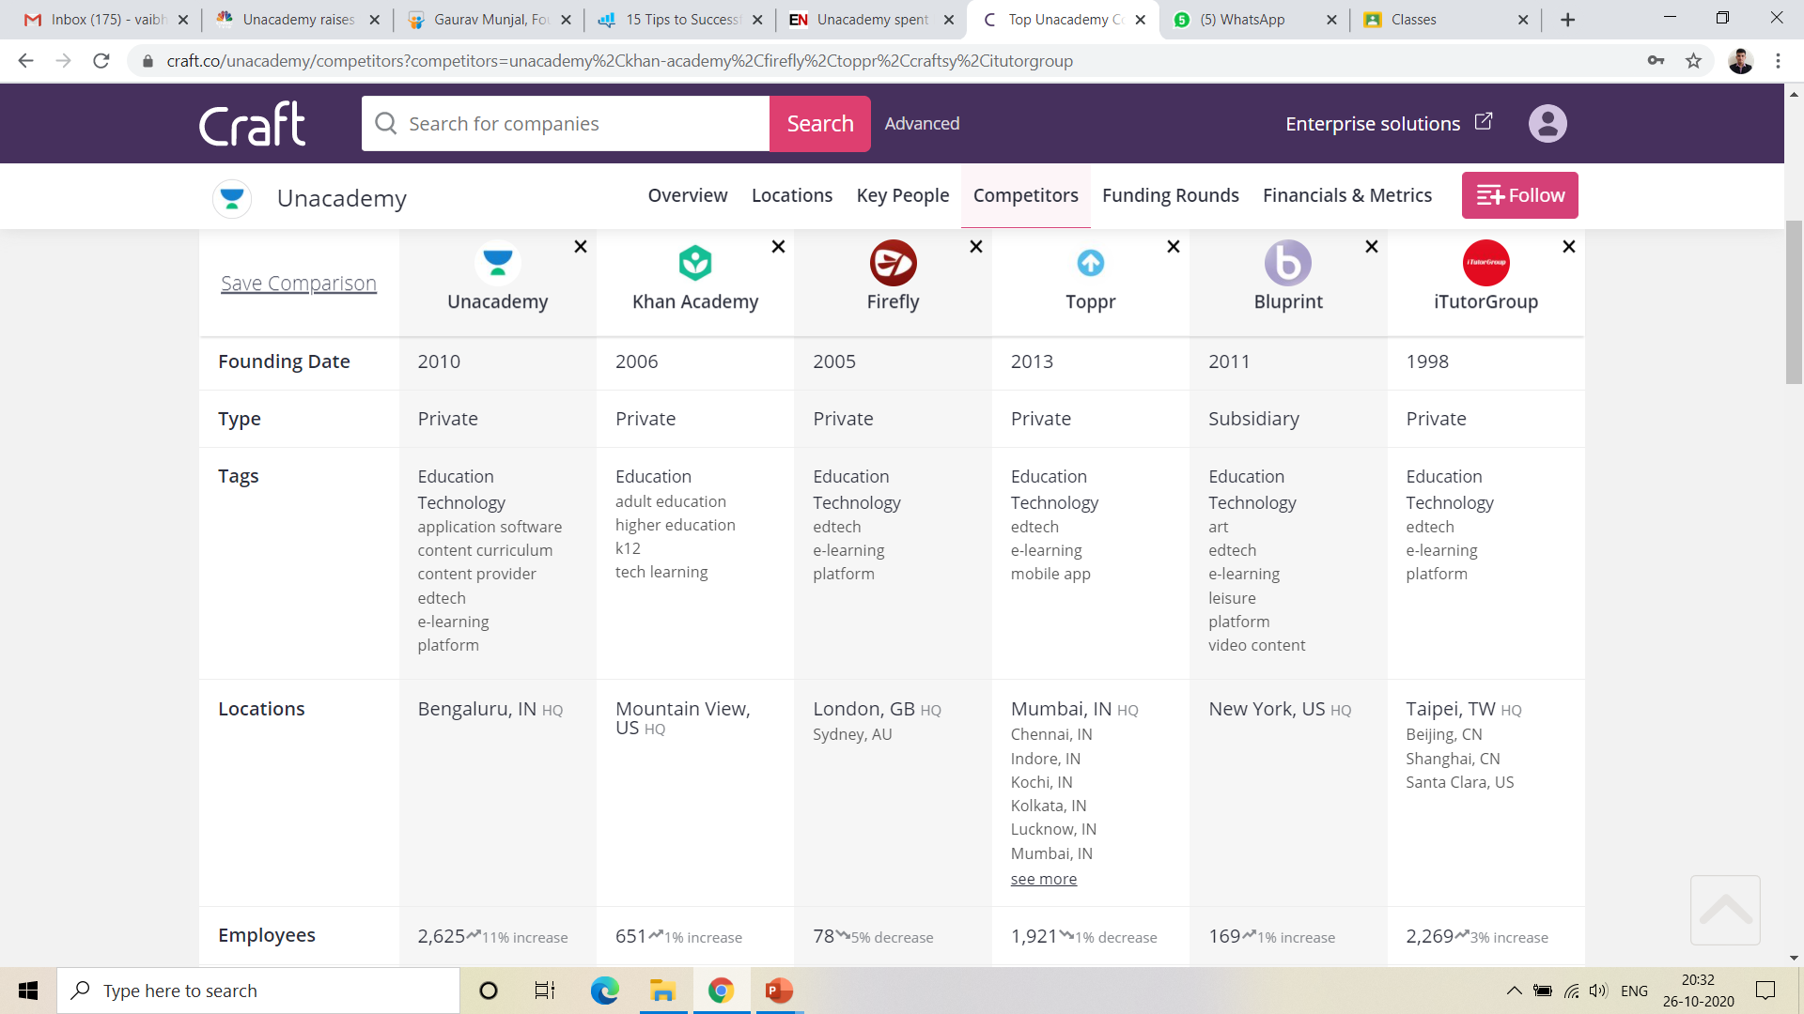
Competitor Analysis

Slide 14
Short Conclusion on Insights
By now you people are quit aware that how much unacademy has achieved in very short span of time with its unique and fair approach towards education, despite the competitors who have started even before us and are no where around us at present. Let’s now take a glance at our upcoming strategies,

Slide 15
Our Upcoming Strategies
To access the advertising world through our huge platform
We are providing almost 80% of data for Free in the form of pre-recorded videos.
Where, the daily active users crosses 500k people (only the app statistics), so putting ads in the pre recorded videos will generate more revenues for us and also we are providing combo packs where we will provide study materials plus ad free experiences.

Slide 16
Our Proposal for users of Unacademy
(Monthly basis)
BASIC
REGULER
PRO
ULTIMATE
 | AD-Free
 | -
 | -
 | -
 | BUY
 | AD-Free
 | Unacademy Plus sub for 7 days
 | -
 | -
 | BUY
 | AD-Free
 | Unacademy Plus sub for 21 days
 | Free Mock Papers
 | -
 | BUY
 | AD-Free
 | Unacademy Plus sub for 30 days
 | Free Mock Papers
 | Doubt Solving Sessions Free
 | BUY
₹99
₹189
₹289
₹799

Slide 17
THANK YOU
We are open for Discussion
Presentation by Vaibhav Sheth

